Slide 2
CORPORATE BRIEFING SESSION- 18TH November 2020 Presented by: Umer Shehzad, CEO
ALTERN ENERGY LIMITED

Slide 3
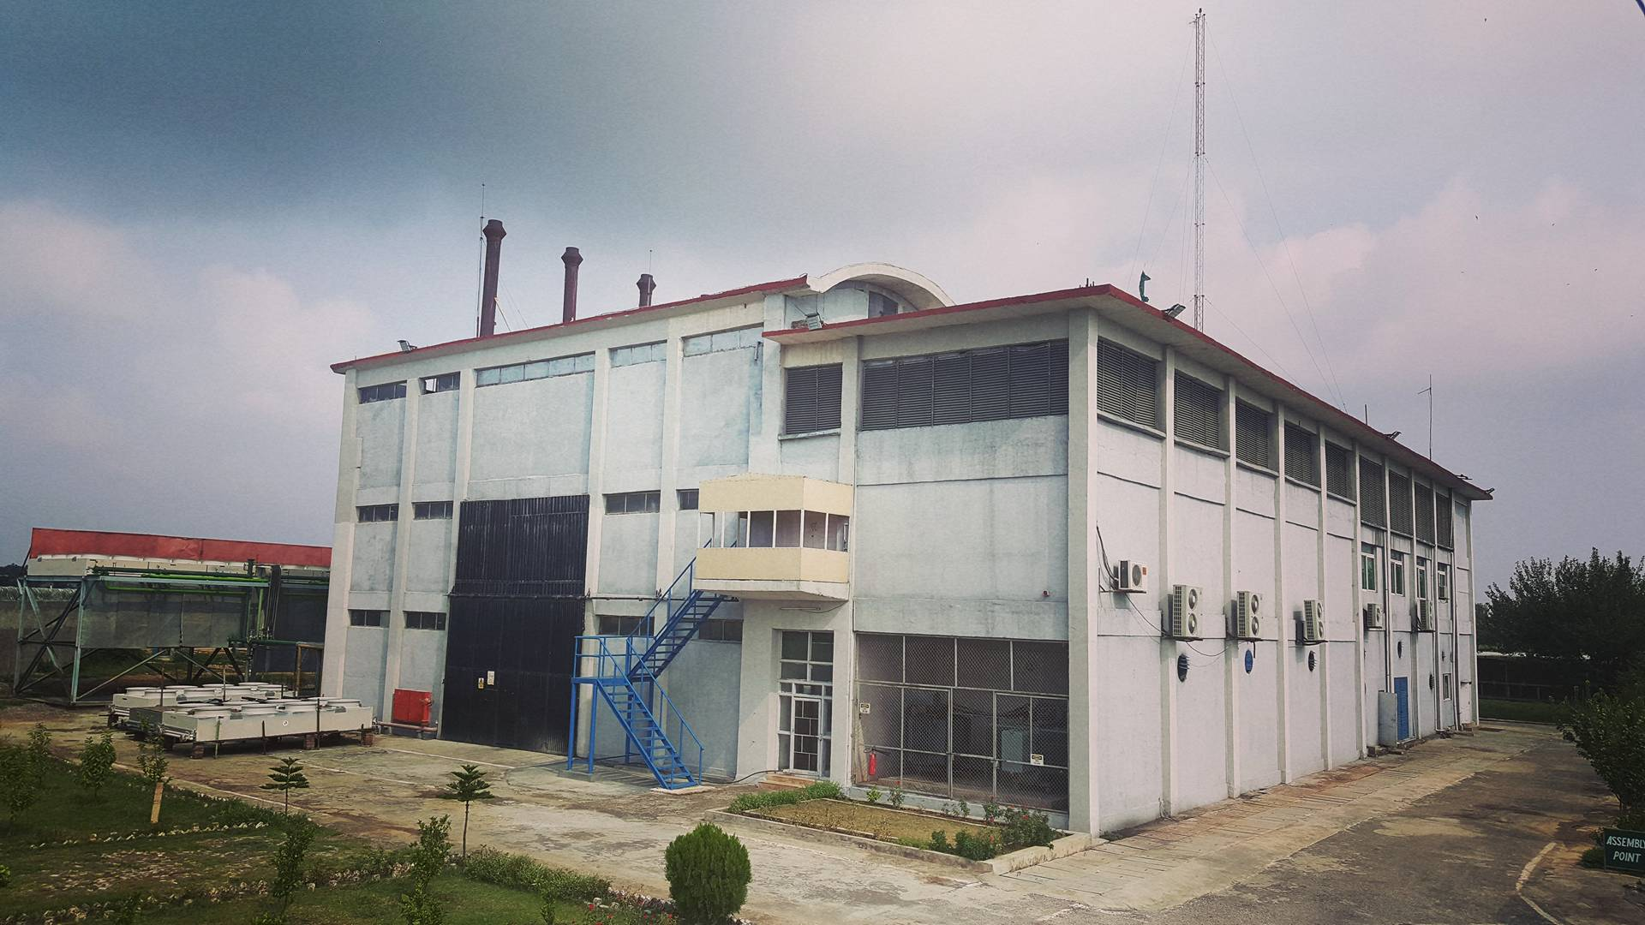
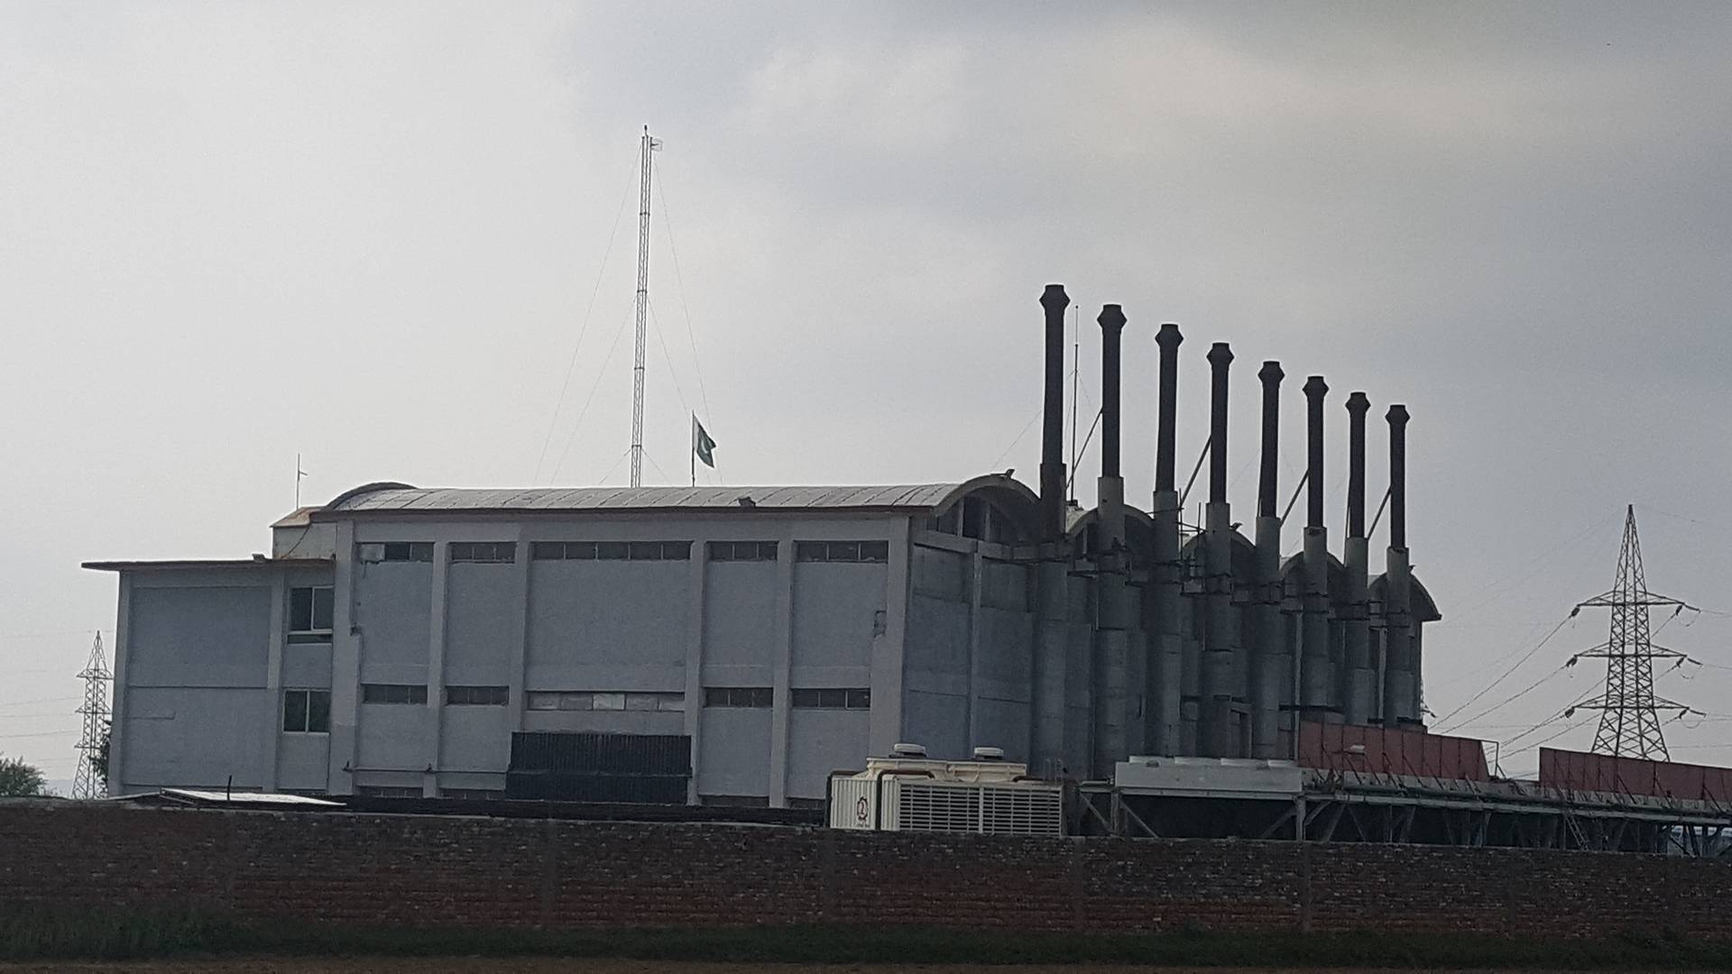
AEL POWER PLANT
AEL POWER PLANT

Slide 4
PROJECT INFORMATION
Type Independent Power Producer
Power Policy 1994 Power Policy
Off-taker Central Power Purchasing Agency (Guarantee) Limited (CPPA-G); formerly WAPDA
Location Kohat Road near Fateh Jang
Commissioned 2008
Financial Close Phase I – July 1996
Phase II - Dec 2007
Project Completion Phase I - June 2000
Phase II - Sep 2008
Major Contracts
Power Purchase Agreement (PPA)
Implementation Agreement (IA)
Gas Supply Agreement (GSA)

Slide 5
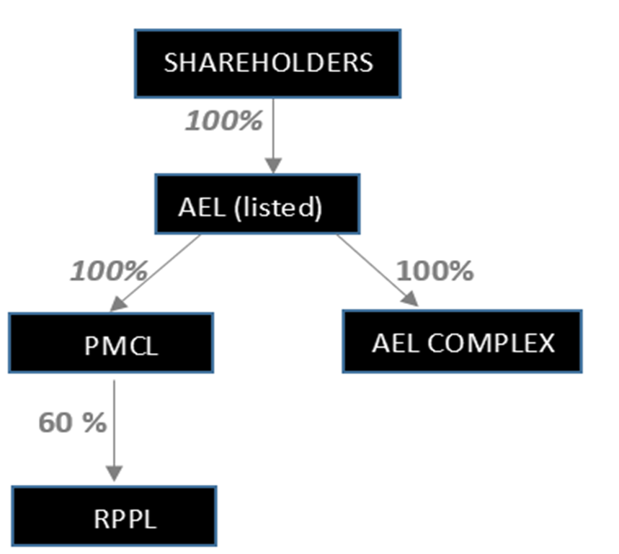
COMPANY STRUCTURE

Slide 6
IMPLEMENTATION AGREEMENT
IA grants to the Company the exclusive right to design, finance, insure, construct, complete, own, operate and maintain the Complex
GoP guarantees the performance obligations of CPPA-G and SNGPL under the PPA and GSA respectively
IA provides protections against political force majeure, changes in law, tax and other fiscal concessions
IA provides GoP guarantee which secures the payment obligations of CPPA-G
The Agreement and the rights & obligation of the parties governed by and construed in accordance with the laws of England (without regard to conflicts of law rules)

Slide 7
Power Purchase Agreement (PPA)
PPA signed between AEL and WAPDA having a term of 30 years from the Commercial Operation Date (COD) starting from June 6, 2001
In 2017, as a result of a Novation Agreement, all the rights and obligations of WAPDA have been transferred to CPPA-G
PPA defines rights and obligations of each contracting party.
PPA defines technical limits, dispatch mechanism, tariff, metering, invoicing, liquidated damages and default scenarios and their remedies for both parties.
PPA sets out the principal terms & conditions for sale of energy by the Company, and the payment thereof, by CPPA-G
The payments are payable by CPPA-G in respect of each unit of energy exported under “take and pay” arrangement

Slide 8
GAS SUPPLY AGREEMENT (GSA)
GSA defines the rights and responsibilities of AEL & SNGPL for sale and purchase of natural gas
Daily contract quantity – 6 MMSCFD of gas per day
Term of the Agreement – 30 June 2013
* Currently, Interim tri-partite GSA on RLNG is under the process of execution
Interim GSA is being executed between the Company, SNGPL and CPPA-G
This interim GSA mainly aligns the payment cycle of RLNG between AEL and SNGPL and corresponding billing and payment cycle between AEL and CPPA-G.
This interim GSA is valid till execution of long term GSA on RLNG.

Slide 9
PLANT INFORMATION
Capacity 31.2 MW at ISO conditions
Technology IC Engines – simple cycle
Fuel Natural Gas / RLNG
Backup Fuel No provision
Interconnection 66 kV via In-out transmission connected with Fateh jang and Jand Grid Stations
Key Equipment 8 Gas-Fired engines (3.9 MW capacity each) TCG 2032 V16 model
Manufacturer MWM (Formerly Deutz, Germany)
Operating Hours 63,000 hrs.
Exported Units 1,764,115 MWh
Project Cost PKR 1,100 Million
Total Land 223 Kanals

Slide 10
FINANCIAL HIGHLIGHTS

Slide 11
REASONS FOR DECLINE IN OPERATIONAL INCOME
Reduced dispatch demand from the off-taker
Company’s low position on economic dispatch merit order of CPPA-G
Influx of new/ more efficient power plants in the national grid system in the last 2/3 years (approx.. 13,000 MW)
Plant operations shifted on RLNG in September 2017 due to declining local gas resources.
Increase in RLNG price during the last 2 years due to:
Pak Rupee devaluation against US$
Increasing Brent prices in international market

Slide 12
MERIT ORDER SCENARIO
Till Sep 2017
Plant operations Local /indigenous gas
Gas price Rs. 600 / MMBTU
AEL’s EPP price Rs. 5.92 / KWh
AEL’s merit order position 9
Current Scenario
Plant operations RLNG
Current RLNG price Rs. 1087.84 / MMBTU
AEL’s EPP price phase I= Rs. 9.539 / KWh
Phase II = 11.935 / KWh
AEL’s merit order position Phase I = 58
Phase II = 38

Slide 13
KEY GENERATION DATA

Slide 15
ISSUES OF POWER SECTOR
High cost of electricity
Circular debt
Under-utilization of ‘Take or Pay’ power plants
In- efficient public sector power generation (GENCOs) plants
Use of cheaper gas fuel by in-efficient plants
Non-availability of RLNG to power plants
Centralized control of DISCOs and GENCOs

Slide 16
ISSUES OF POWER SECTOR
In-adequate infrastructure between NTDC and K-Electric system for import/export of electric power beyond 650 MW
Ineffective demand side management.
Higher Transmission and Distribution losses
Low recoveries of DISCOs

Slide 17
COUNTRYWIDE GENERATION CAPACITY
 |  |  |  | figures in Mega Watts
As at June 30 | 2016 | 2017 | 2018 | 2019 | 2020
Hydel | 7,116 | 7,116 | 8,713 | 9,761 | 9,861
Thermal | 16,701 | 18,989 | 24,020 | 25,670 | 25,244
Nuclear | 752 | 1,142 | 1,467 | 1,467 | 1,467
Renewable Energy ( Wind, Solar & Bagasse) | 852 | 1,465 | 1,779 | 2,097 | 2,147
TOTAL | 25,421 | 28,712 | 35,979 | 38,995 | 38,719

Slide 18
COUNTRYWIDE GENERATION BY TYPE
 |  |  |  | Figures in GWh
Electricity Generation by Type | 2016 | 2017 | 2018 | 2019 | 2020
Hydel | 34,554 | 32,079 | 28,069 | 33,096 | 38,988
Thermal | 73,672 | 78,818 | 92,011 | 89,403 | 81,555
Nuclear | 4,216 | 6,278 | 9,051 | 9,136 | 9,898
Import | 463 | 496 | 555 | 487 | 514
Renewable Energy ( Wind, Solar & Bagasse) | 1,187 | 2,950 | 3,907 | 4,898 | 4,305
TOTAL | 114,093 | 120,622 | 133,593 | 137,019 | 135,259

Slide 19
INSTALLED CAPACITY VS DEMAND
As at June 30 | 2016 | 2017 | 2018 | 2019 | 2020
INSTALLED CAPACITY | 25,421 | 28,712 | 35,979 | 38,995 | 38,719
DEMAND | 26,462 | 27,560 | 28,830 | 28,369 | 28,672
DIFFERENCE | (1,041) | 1,152 | 7,149 | 10,626 | 10,047

Slide 20
KEY CHALLENGES AND THEIR MITIGATING TASKS
Execution of GSA
Continuous follow-up with the Ministry of Energy (Power Division), Ministry of Petroleum, CPPA-G and SNGPL
Circular Debt
Continuous follow-up with Ministry of Energy and CPPA-G earliest release of outstanding overdues
To ensure commercial sustainability of the project, the management has pursued the GoP for the following mitigating activities, without any positive response:
Efforts for allocation of indigenous gas from GoP
Efforts for procurement of indigenous gas from private resources
Coordination with GoP for take-or-pay tariff of capacity payments

Slide 21
MATERIAL INFORMATION
Negotiations with the Government
The Government formed a Negotiating Committee to negotiate with IPPs on various tariff related concessions.
On August 25, 2020, AEL formally requested the Negotiating Committee to terminate its PPA on the terms to be mutually agreed between the company and the Committee, however, no response has been received from the Committee till-date.
The Committee has submitted its report to the ECC of Federal Cabinet wherein it has given its recommendation for termination of AEL, along with recommendations of other IPPS in the form of MoUs.
Subsequently, the Government formed an implementation committee for executions of amendments of Agreements with IPPs in light of the recommendations of the Negotiating Committee.
However, there is no risk of GOING CONCERN since Company’s investment in subsidiary Rousch Power is intact.

Slide 22
ALTERN ENERGY LIMITED
Questions
ANY

Slide 23
ALTERN ENERGY LIMITED
Thankyou

